Slide 1
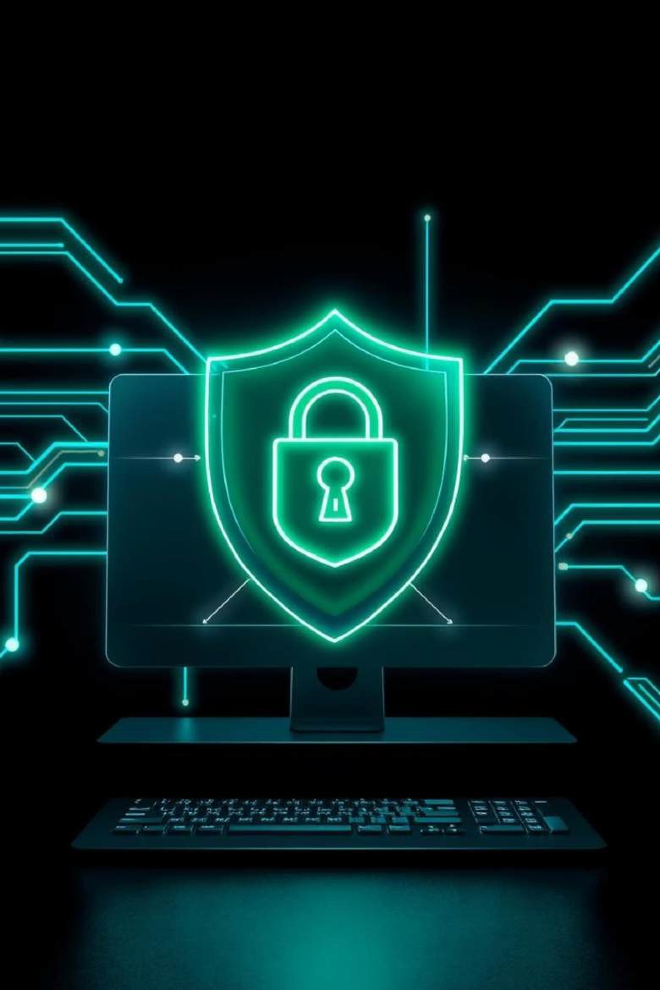

Phishing Attacks: Stay Safe Online
Understanding and preventing phishing attacks is crucial in today's digital world. This presentation will equip you with the knowledge to recognize threats and protect yourself.
by Rohitkumar Dhapade

Slide 2
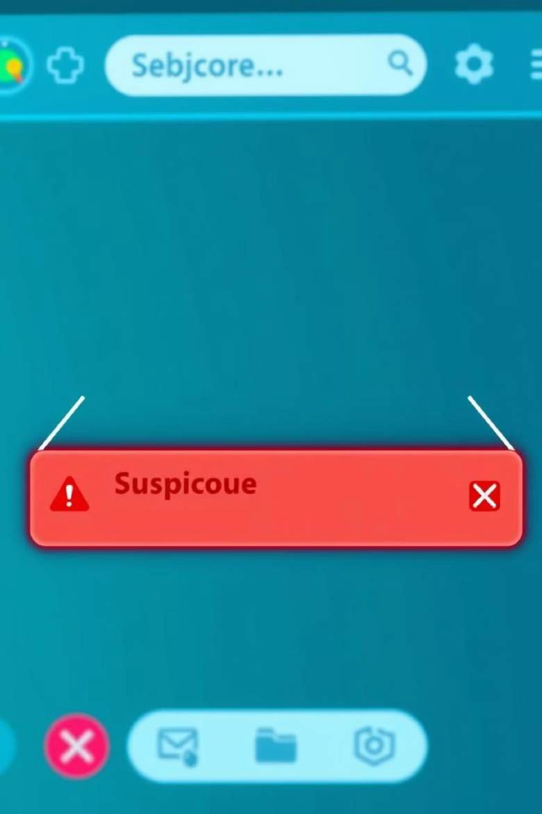
Recognizing Phishing Emails
Suspicious Sender
Check the sender's email address carefully for inconsistencies.
Urgent Language
Beware of emails demanding immediate action or threatening consequences.
Generic Greetings
Phishing emails often use generic greetings instead of your name.
Bad Grammar
Look for typos, grammatical errors, or awkward phrasing.

Slide 3
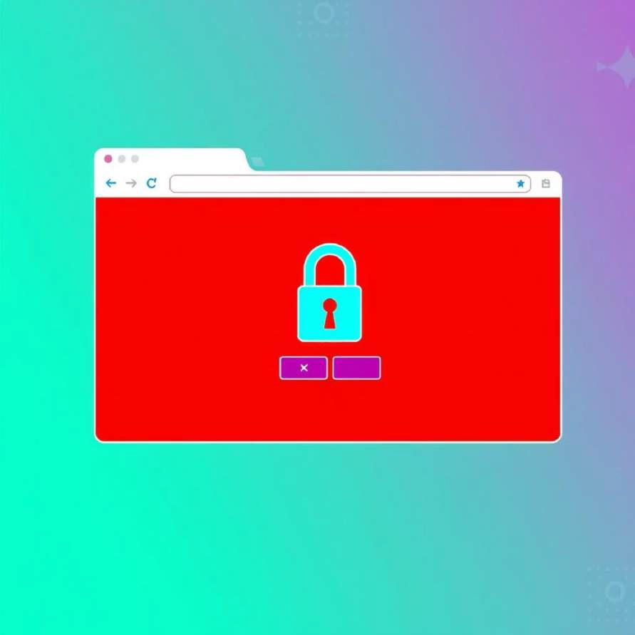
Identifying Fake Websites
URL Mismatches
Always verify the website's URL. Look for subtle misspellings or unusual domains.
No HTTPS
Legitimate sites use HTTPS (secure connection). Check for the padlock icon in the address bar.

Slide 4



Social Engineering Tactics
Pretexting
Attackers create a fabricated scenario to gain your trust and information.
Baiting
Offering something enticing (e.g., free downloads) to trick you into clicking malicious links.
Quid Pro Quo
Promising a service or benefit in exchange for your personal information.

Slide 5
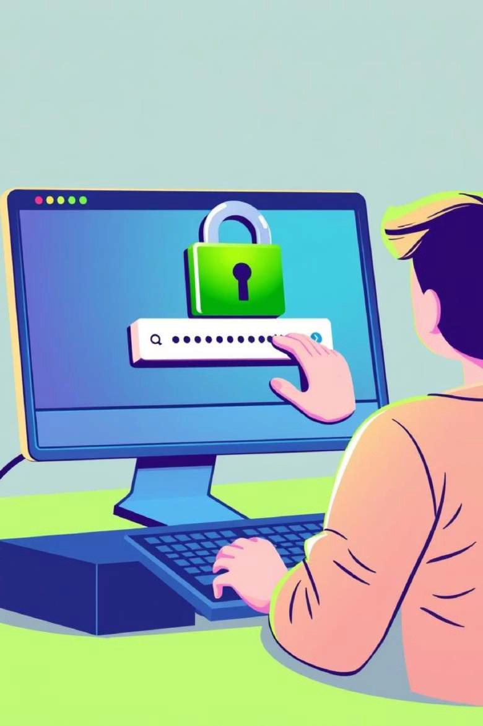
Best Practices to Avoid Phishing
Verify Sender
Always double-check the sender's identity before responding or clicking.
Hover Over Links
Before clicking, hover your mouse over links to see the actual URL.
Use Strong Passwords
Create unique, complex passwords and consider using a password manager.
Enable 2FA
Two-Factor Authentication adds an extra layer of security to your accounts.

Slide 6
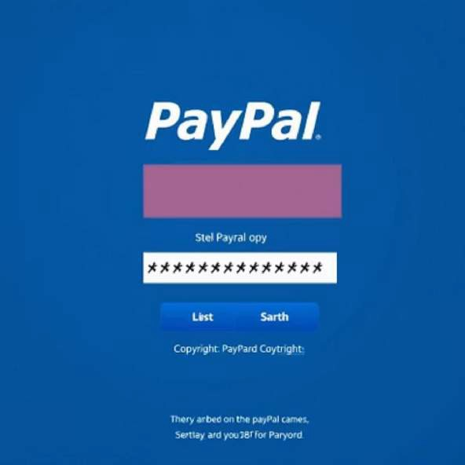
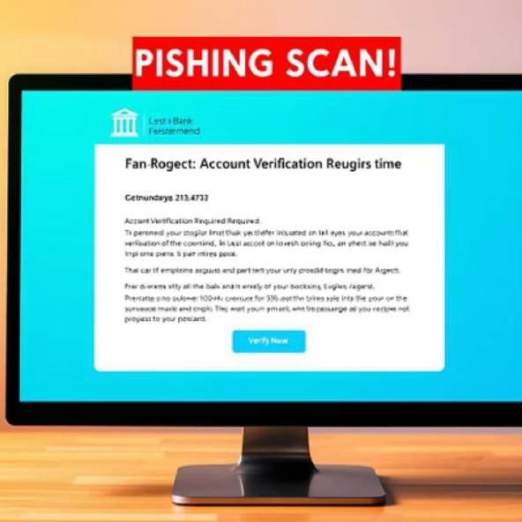
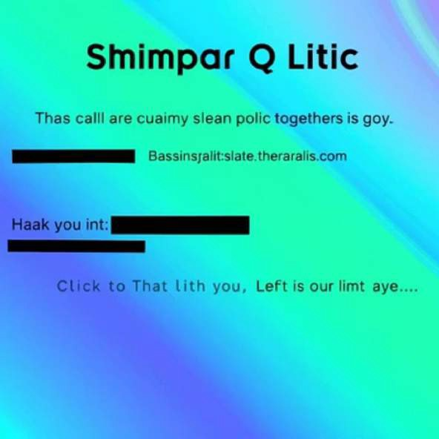
Real-World Examples
Phishing attacks often mimic legitimate brands and services. These examples show how convincing they can be.

Slide 7
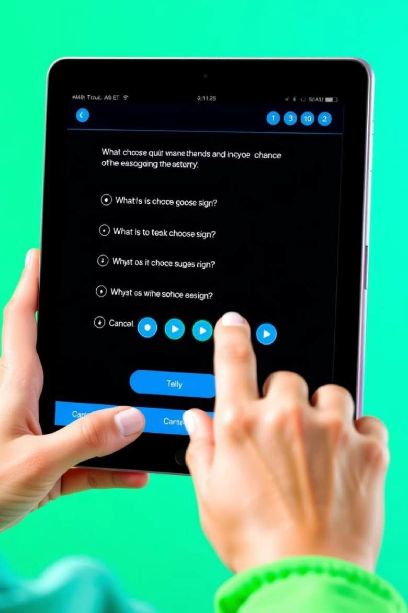

Interactive Quiz: Test Your Knowledge
Test your ability to spot phishing attempts with our interactive quiz.
Can you identify the red flags?
Click here

Slide 8

Key Takeaways & Next Steps
Stay Vigilant
Always be suspicious of unsolicited emails and unexpected requests.
Educate Yourself
Continuously learn about new phishing tactics and security measures.
Report Incidents
If you suspect a phishing attempt, report it to your IT department or relevant authorities.

Slide 9
Thank You…..

